Slide 1
Introduction to Computer Vision with OpenCV

Slide 2
Outline
Introduction to Computer Vision
Definition of Computer Vision and its applications
Overview of techniques being used in Computer Vision
Installing Python and External Packages
How to install Python and Python IDE
Introduction to pip for installing external packages
Introduction to OpenCV and NumPy
What is OpenCV and its uses
Installing OpenCV
Reading, displaying, and saving images using OpenCV
How OpenCV uses NumPy arrays for image processing
Basics of Images
Definition of digital images
Image size
Types of images (binary, grayscale, color)
Image file formats (JPEG, PNG, BMP)
Coding Examples
Reading and displaying an image using OpenCV
Basic image manipulation using NumPy (converting to grayscale, resizing, cropping, rotation)
Image filtering using NumPy (blurring, sharpening)
Drawing shapes and text on images using OpenCV
Object detection using OpenCV (such as face detection)
3D Body Pose Estimation

Slide 3
Definition and Overview

Slide 4
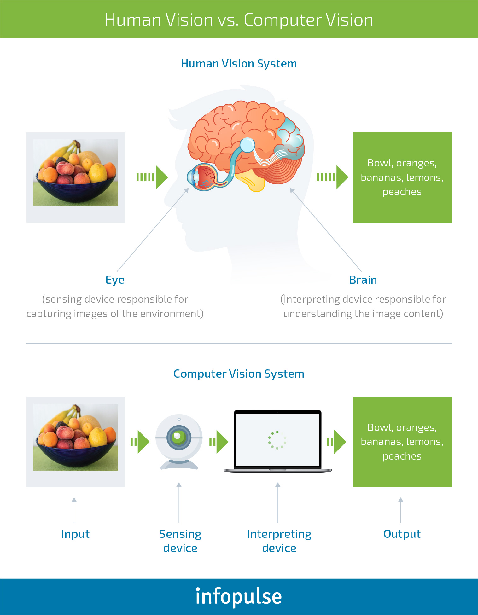
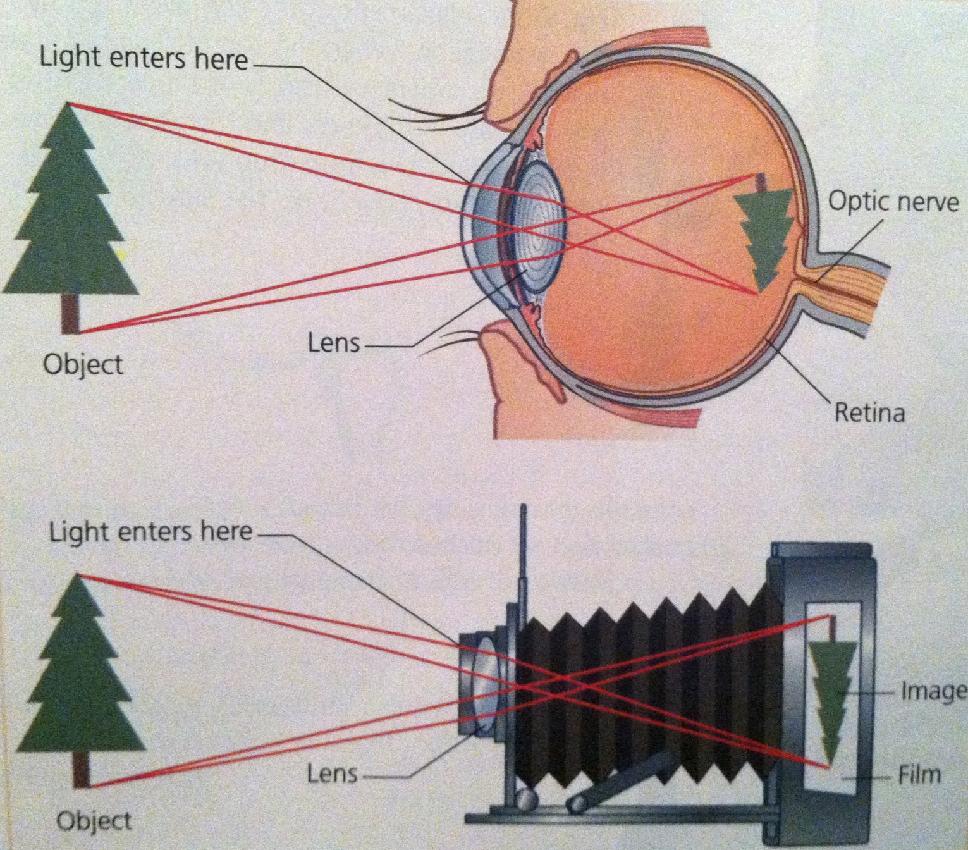

Slide 5
What is Computer Vision
Computer Vision is a field of artificial intelligence that enables computers to understand and analyze images and videos, with the goal of automating tasks that would normally require human visual perception.
It involves the development of algorithms and techniques that enable computers to extract meaningful information from images and videos.

Slide 6
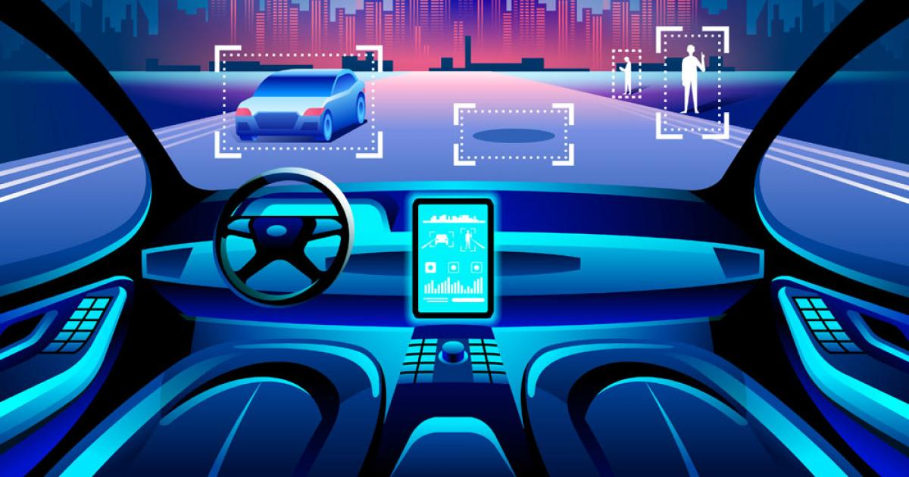
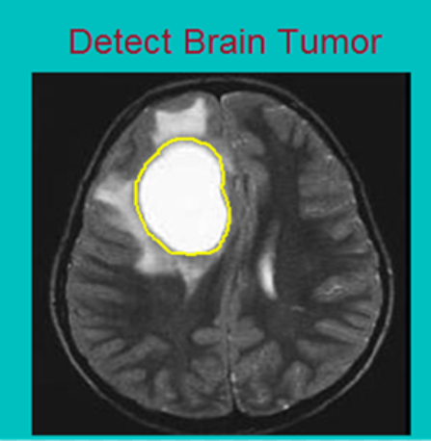
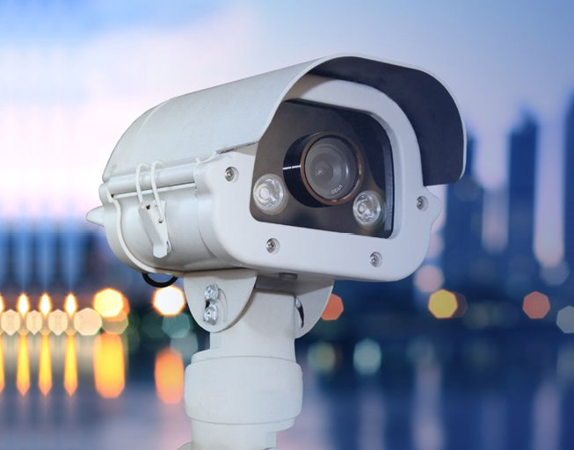
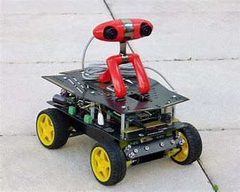
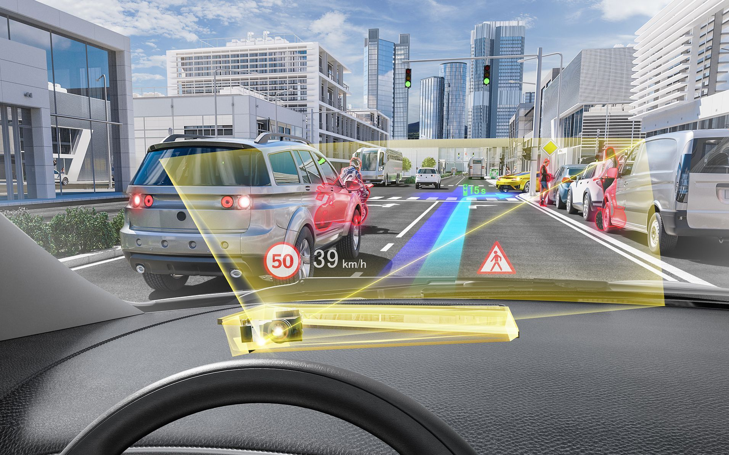
Applications
Autonomous Vehicles
Medical Image analysis
Security and Surveillance
Robotics
Augmented Reality
Quality Control

Slide 7
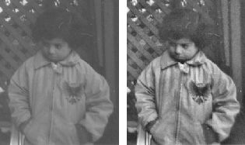
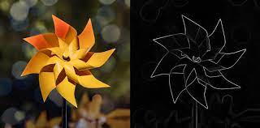
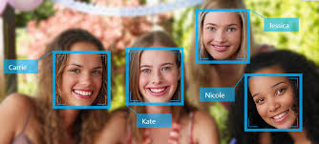
Computer Vision techniques can be classified into…
Traditional techniques: (Today we will cover a little bit of it)
Mostly rely on hand-crafted algorithms (features that are manually extracted for example number of red pixels) and simple machine learning algorithms (clustering, regression, decision tree ,...) that may not be able to handle variations in data.
Some important techniques:
Image Filtering: Techniques used to filter or enhance images, such as smoothing or sharpening filters.
Edge Detection: Techniques used to detect edges or boundaries in images.
Object Detection: Techniques used to detect objects (for example faces) in images, such as, Haar cascades classifier.
Deep learning-based techniques:
The more the data the better the results

Slide 8
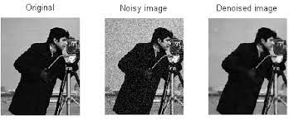
Computer Vision techniques
It is important to note that these techniques can be combined in various ways to solve different computer vision tasks.
For example, we almost never start training a deep learning model without first preparing the data, as this can significantly affect the final results.
Image denoising is one of the most important preprocessing tasks in deep learning, and traditional techniques can be helpful in achieving this

Slide 9
Installing Python and External Packages

Slide 10

Downloading Python
Link: https://www.python.org/downloads/

Slide 11

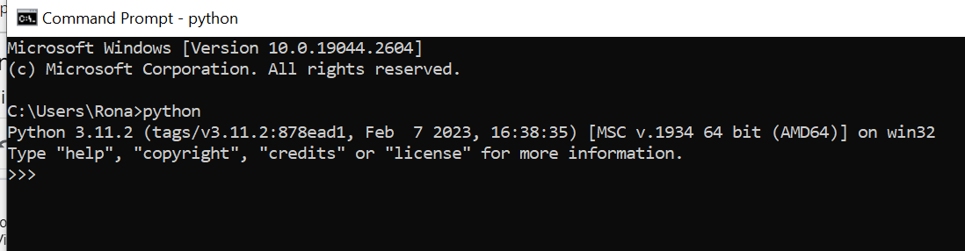
Installing Python
Note: Don’t forget to add python PATH to the environment variable while installing python
Successful installation

Slide 12
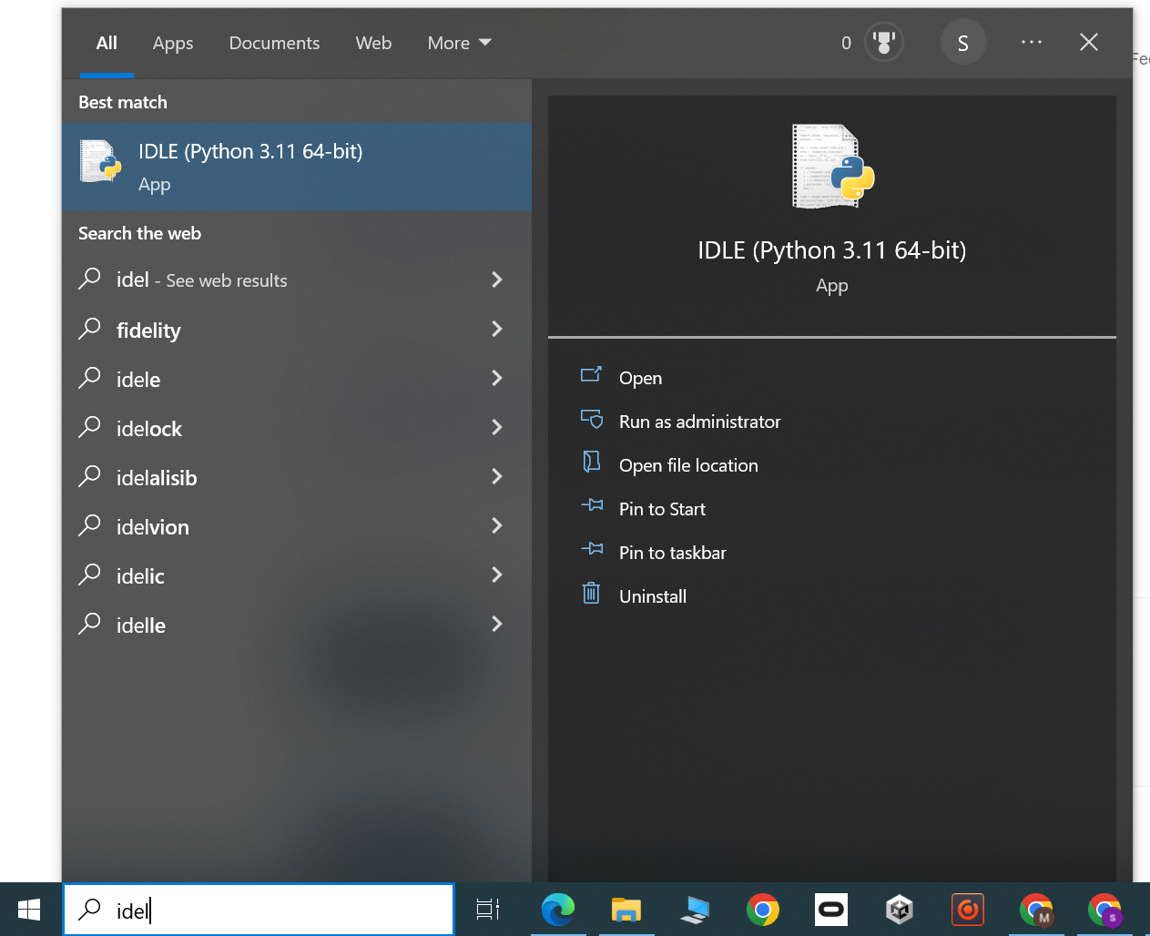
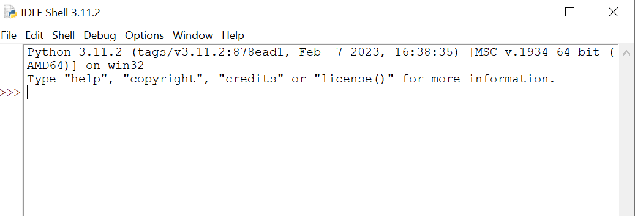
Python IDLE
IDLE is an integrated development environment for Python which will be installed alongside python

Slide 13
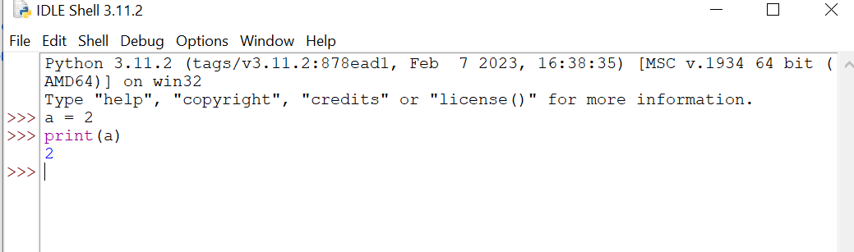
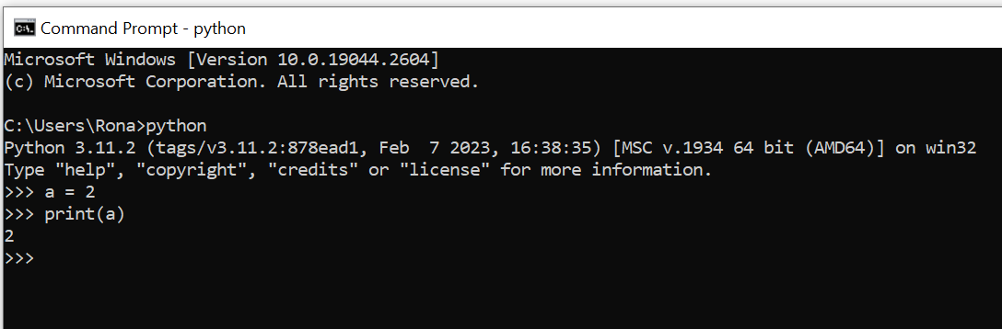
IPython coding
Interactive Python
Running codes line by line
In IDLE
In CMD

Slide 14
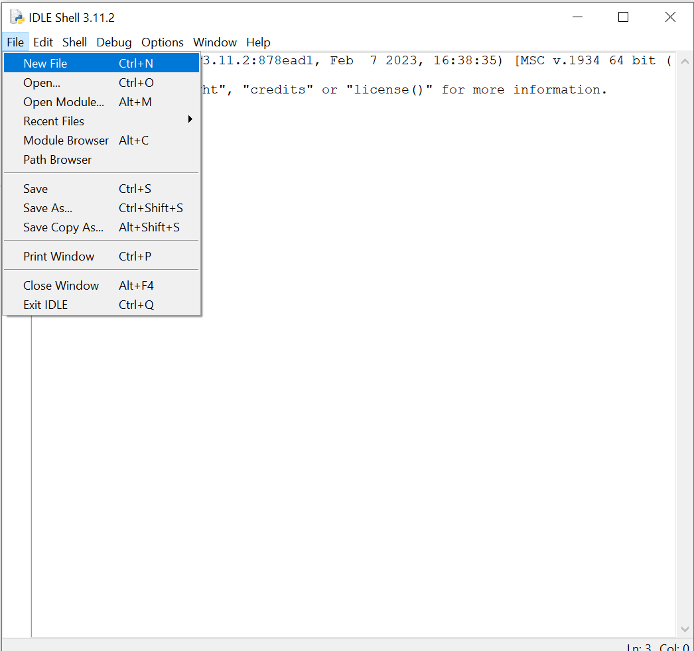
Running python codes as a “.py” file
Create a python file

Slide 15
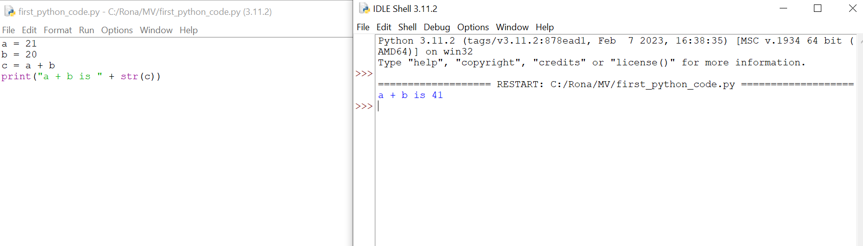
Running python codes as a “.py” file
Press F5 to run the code

Slide 16
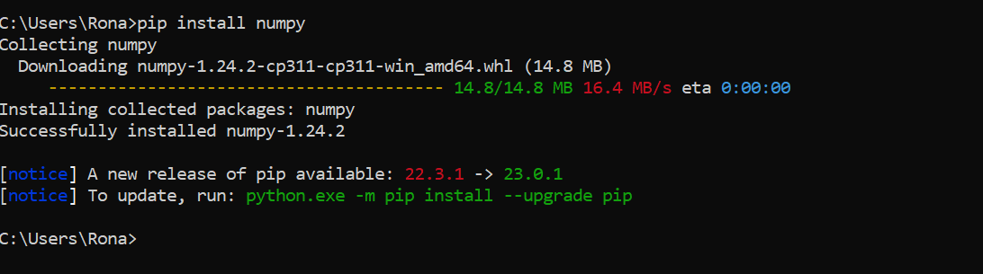
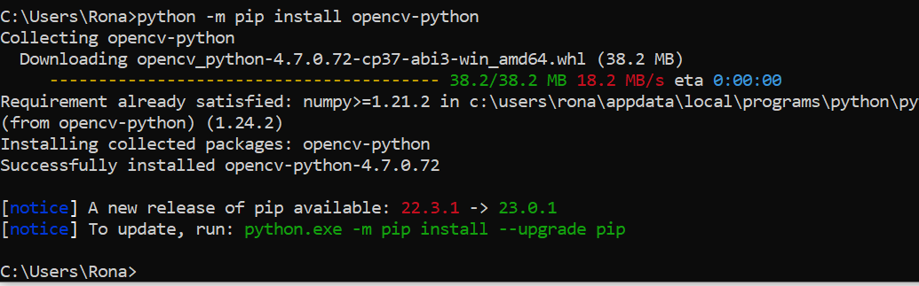
Installing python packages
pip install “package name” Or python -m pip install “package name”
Example:

Slide 17
Introduction to OpenCV and NumPy

Slide 18
What is OpenCV
OpenCV (Open Source Computer Vision Library) is an open-source computer vision and machine learning software library.
// scikit-image
It is a set of programming functions and algorithms that developers can use to perform various tasks related to image and video processing,
These tasks includes object detection and recognition, facial recognition, motion tracking, and more.
Installing : pip install opencv-python

Slide 19
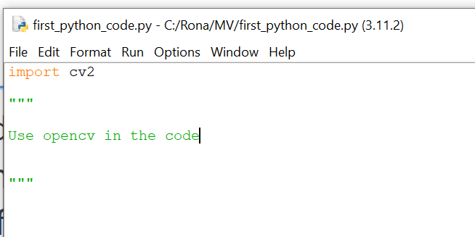
Using opencv
To use external packages in python, we should import them in the code by adding Import “package name” in the code before using that package in the code (mostly on the top of the code)
The package name while importing maybe different from what we use for installing
Example:
Installing opencv: pip install opencv-python
Importing opencv in the code: import cv2

Slide 20
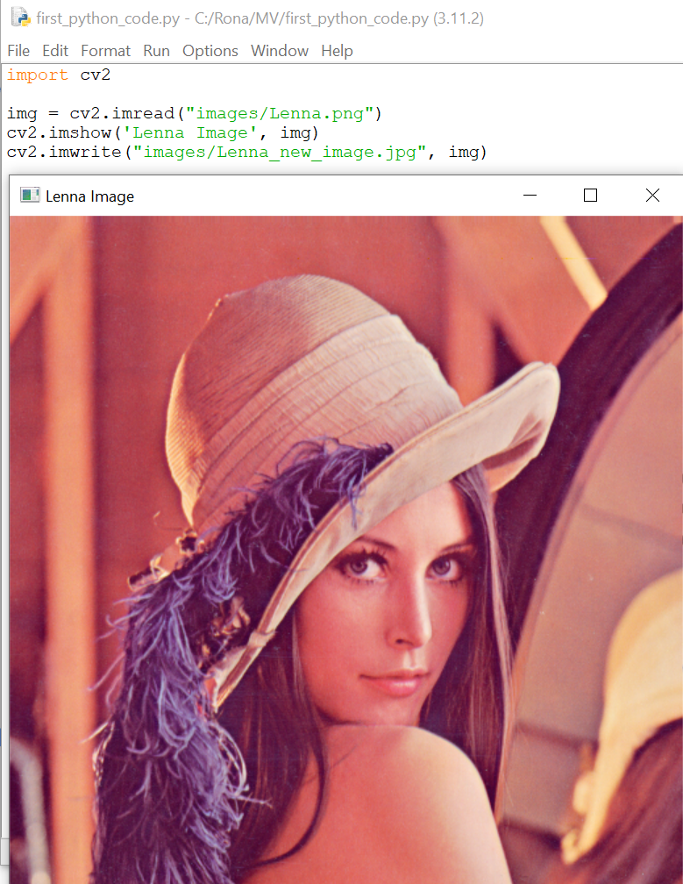
Basic opencv functions
Reading images
image-variable = cv2.imread("Path to image")
ex) img = cv2.imread("images/Lenna.png")
Displaying images
cv2.imshow('window title', image-variable)
ex) cv2.imshow('Lenna Image', img)
Saving images
cv2.imwrite('new_image path and format', new-image-variable)
ex) cv2.imwrite("images/Lenna_new_image.jpg", img)

Slide 21
What is NumPy?
NumPy is a Python library that provides support for…
Large, multi-dimensional arrays and matrices,
A large collection of mathematical functions to operate on them.
NumPy is widely used in…
Scientific computing
Data analysis
Machine Learning

Slide 22
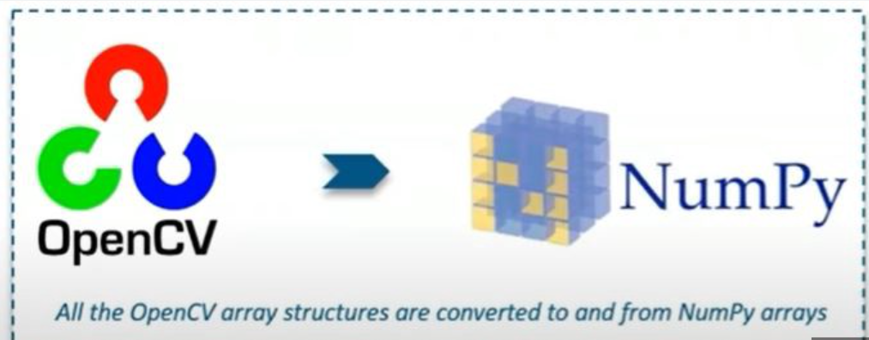
Why we need NumPy in opencv?
In OpenCV, NumPy is used to
represent images and matrices
perform various image processing operations
NOTE: NumPy arrays are the primary data structure used for representing images in OpenCV.

Slide 23
Why we need NumPy in opencv?
When you read an image using OpenCV in Python, it is loaded as a NumPy array.
You can manipulate and process this array using NumPy functions and operations.
For example, you can use NumPy to crop or resize an image, as well as to perform mathematical operations such as addition or subtraction.

Slide 24
Basics of Images

Slide 25
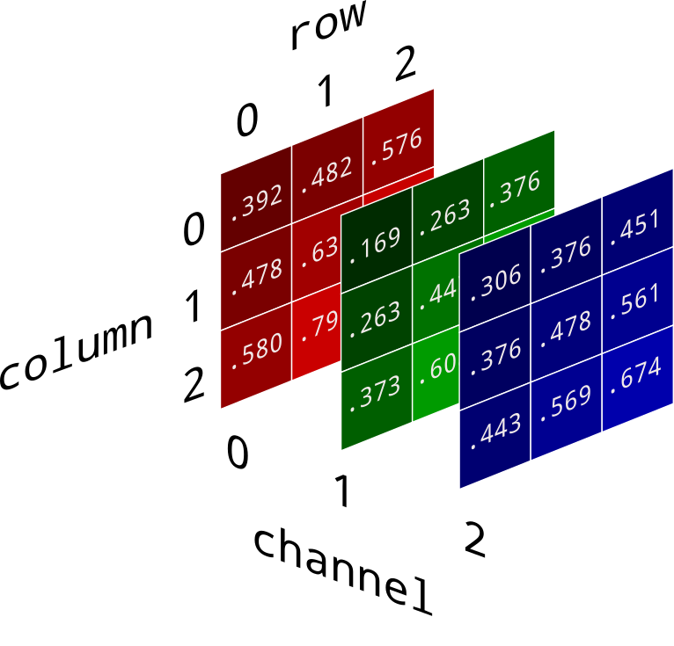
Definition of digital images in numpy
In OpenCV, NumPy arrays are commonly used to define digital images.
A NumPy array is a collection of values that can be thought of as a table with rows and columns.
In the case of digital images, a NumPy array can be used to represent the pixel values of an image.
Pixel values are numerical values that represent the color (and brightness) of a specific pixel in a digital image.
For example in RGB (Red, Green, Blue) images each pixel consists of 3 values.
each of this values can be in (0,255) range.
Blue: (0,0,255)

Slide 26
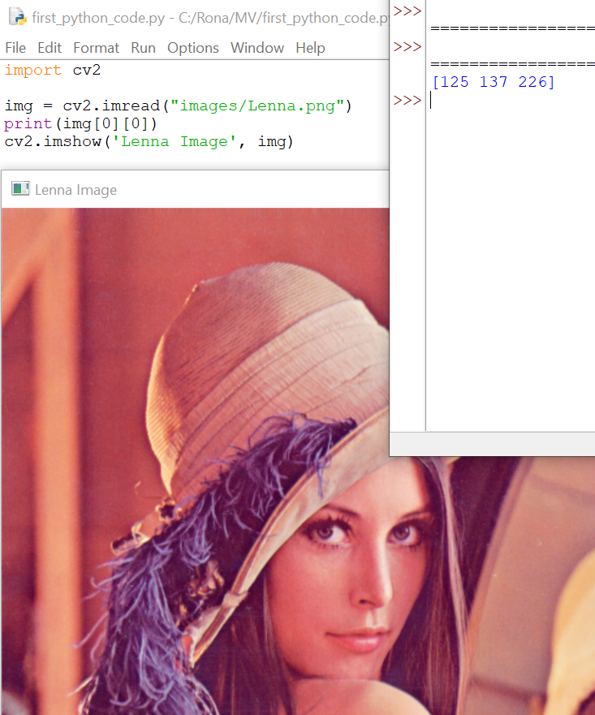
Pixel values in opencv
Pixel value can be accessed by indexing
For example: img[0][0]
B channel = 125
G channel= 137
R channel= 226
Note: opencv uses BGR instead of RGB

Slide 27
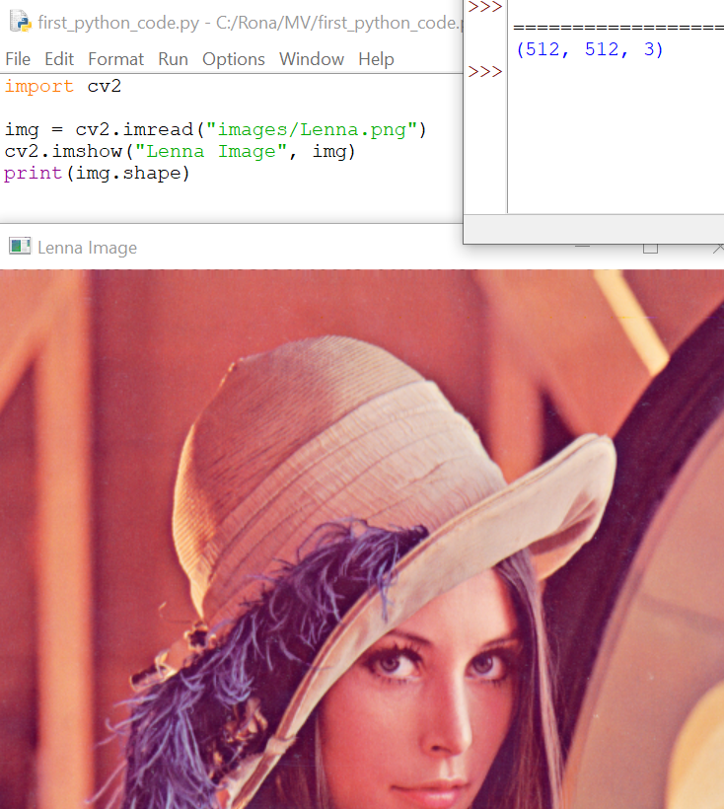
Image size
Image size refers to the physical dimensions of an image, such as its height and width, usually measured in inches, centimeters, or pixels.
In OpenCV image size is measured in pixels.
We can find out the image size using “shape” which is a numpy array command.
Result can be interpreted as : (height, width, channel)
Ex) print(img.shape) —-> result: (512, 512, 3)

Slide 28
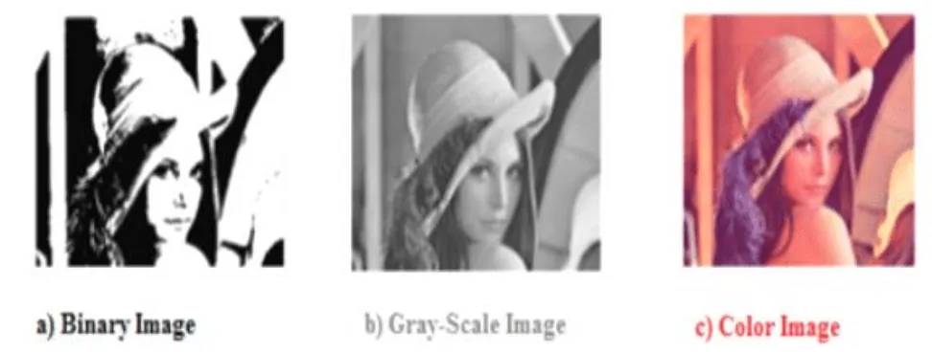
Types of images (binary, grayscale, color)
In OpenCV, there are three main types of images based on the number of color channels they contain.

Slide 29
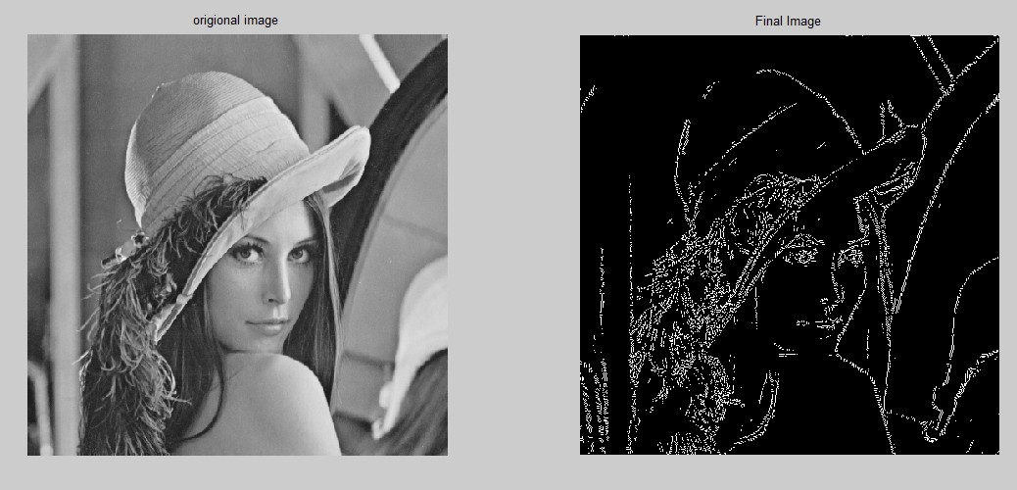
Binary Images
They have only two pixel values, usually black and white,
They are used for simple image processing tasks (such as edge detection)
In OpenCV, binary images are represented as single-channel grayscale images, where each pixel is either black (0) or white (255).
An edge refers to a sudden change between neighboring pixels in an image.

Slide 30
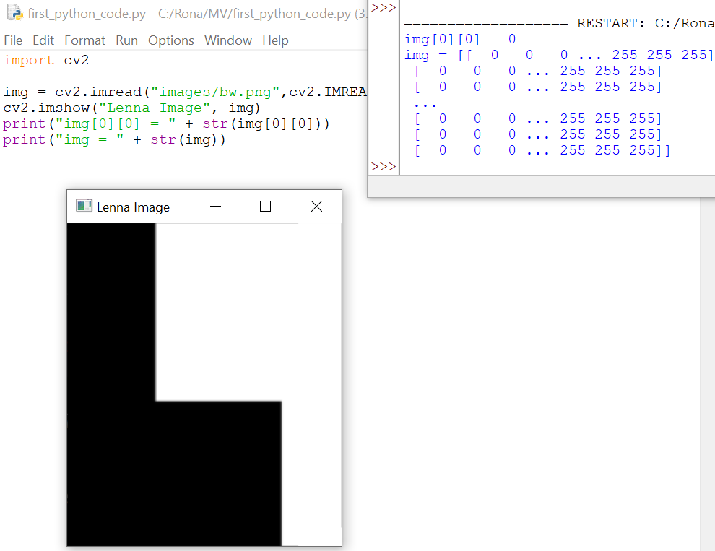
Binary Images
NOTE: The numpy array is 2D

Slide 31
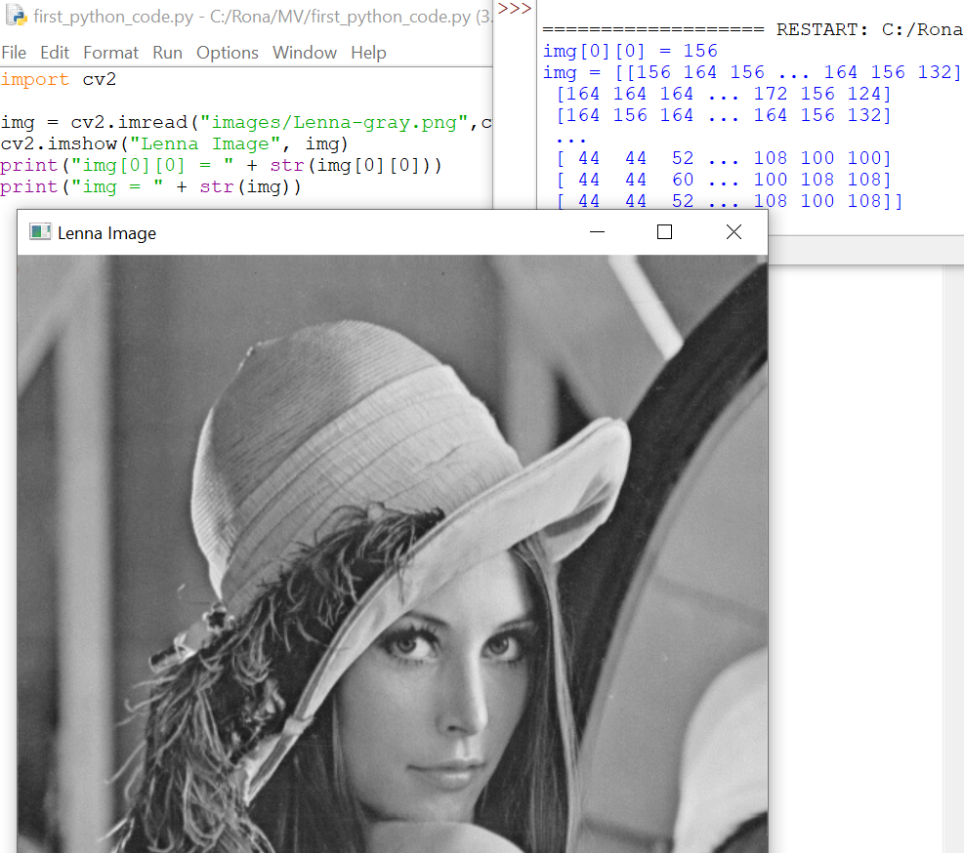
Grayscale Images
Images that contain a single channel representing the value of each pixel.
In OpenCV, grayscale images are represented as single-channel images, where each pixel value can be from 0 (black) to 255 (white).
NOTE: The numpy array is 2D.

Slide 32
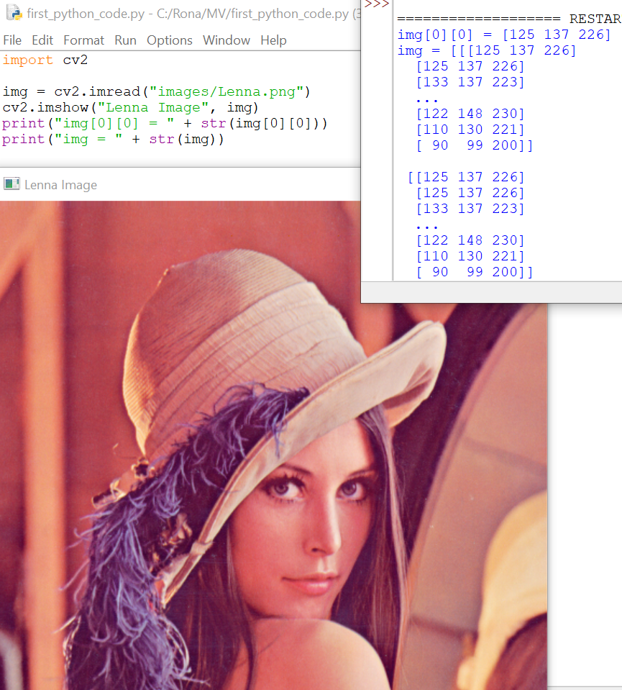
Color Images
Color images are images that contain three color channels, usually red, green, and blue (RGB), or hue, saturation, and value (HSV),and are used to represent the color of each pixel.
In OpenCV, color images are represented as three-channel images, where each pixel has three values each color channel.
NOTE: The numpy array is 3D
Each pixel value has 3 values for color channels.

Slide 33
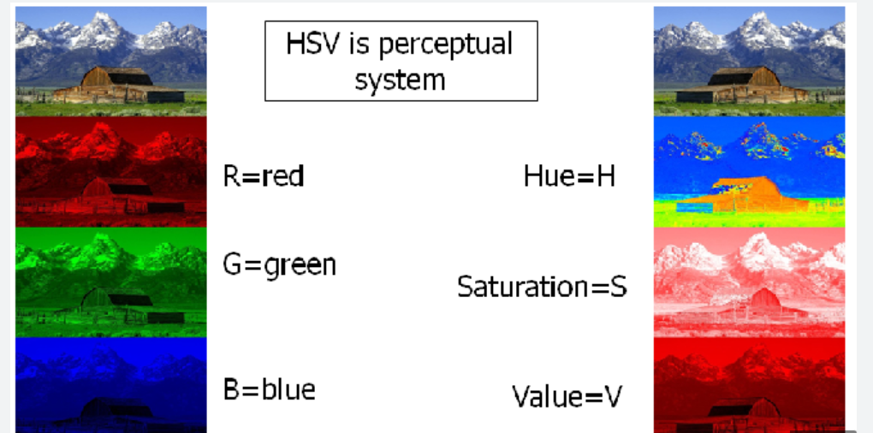
Color Images
We have different Color spaces that RGB is only one of them.
In image processing we mostly use RGB.

Slide 34
Image file formats
OpenCV supports a variety of image file formats (to read and write), including:
JPG/JPEG
PNG
BMP
….

Slide 35
Coding Examples

Slide 36

Reading and displaying images
cv2.imread(“image path”, load-format)
cv2.IMREAD_COLOR → load in color format and do not care about real format of the image
cv2.IMREAD_GRAYSCALE → load in color format and do not care about real format of the image
cv2.IMREAD_UNCHANGED → load the image with its real format

Slide 37
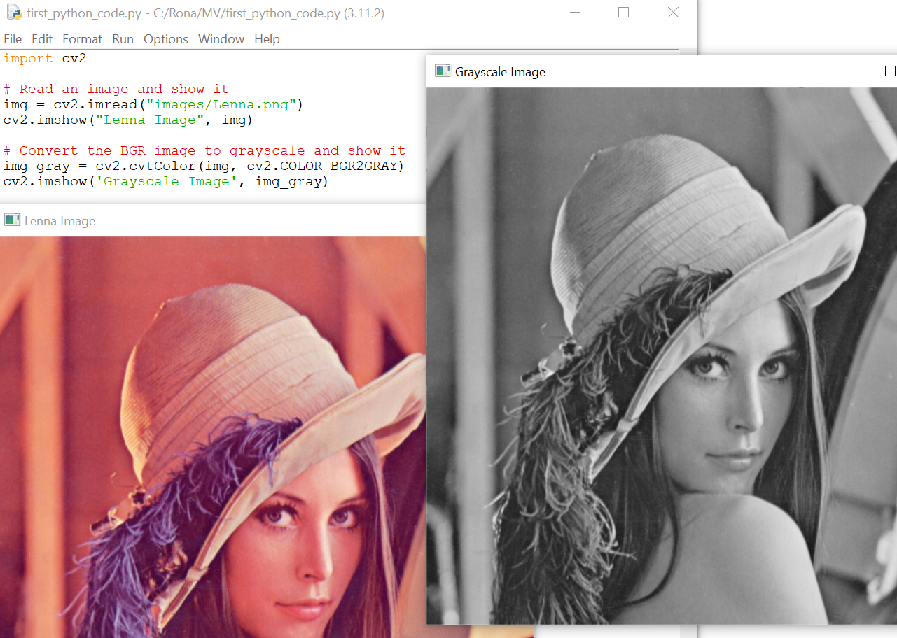
Basic image manipulation
Converting RGB(BGR) image to grayscale
The default image format in opencv is BGR
We can convert RGB to BGR as well

Slide 38
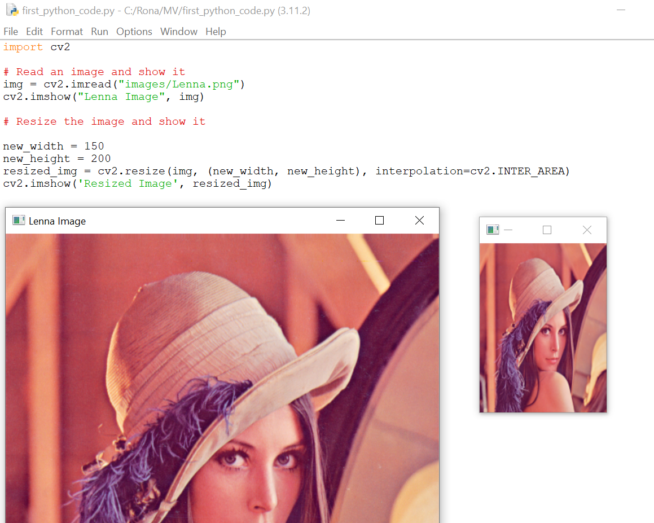
Basic image manipulation
Resizing

Slide 39
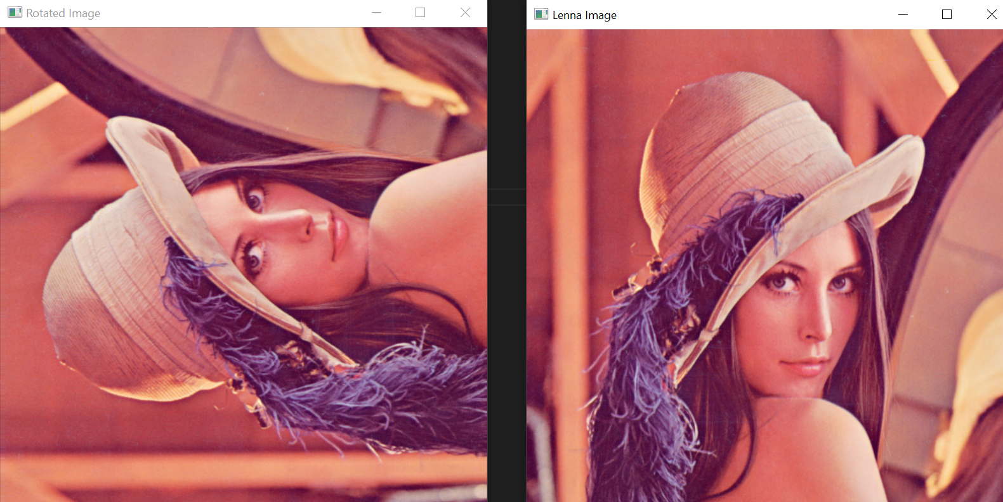
Basic image manipulation
import cv2
# Read an image and show it
img = cv2.imread("images/Lenna.png")
cv2.imshow("Lenna Image", img)
# Rotate the image
img = cv2.rotate(img, cv2.ROTATE_90_COUNTERCLOCKWISE)
cv2.imshow("Rotated Image", img)
cv2.waitKey(0)
Rotation
cv2.ROTATE_90_CLOCKWISE
cv2.ROTATE_180
cv2.ROTATE_90_CLOCKWISE

Slide 40
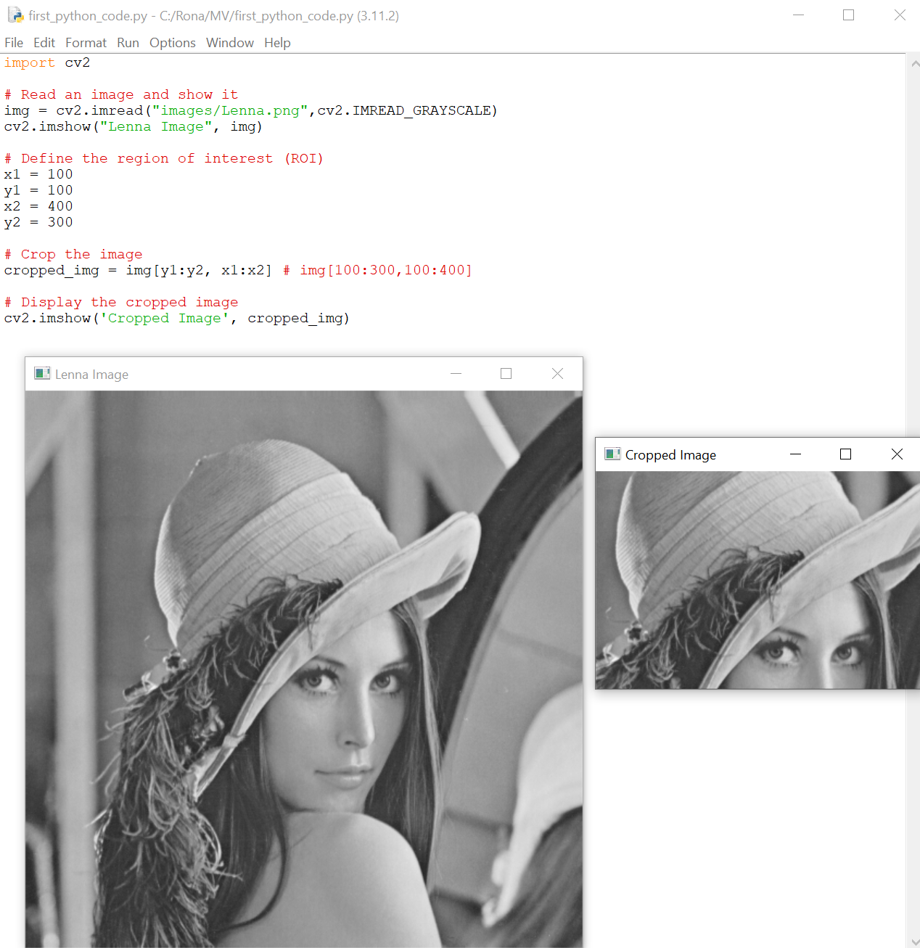
Basic image manipulation
Cropping

Slide 41
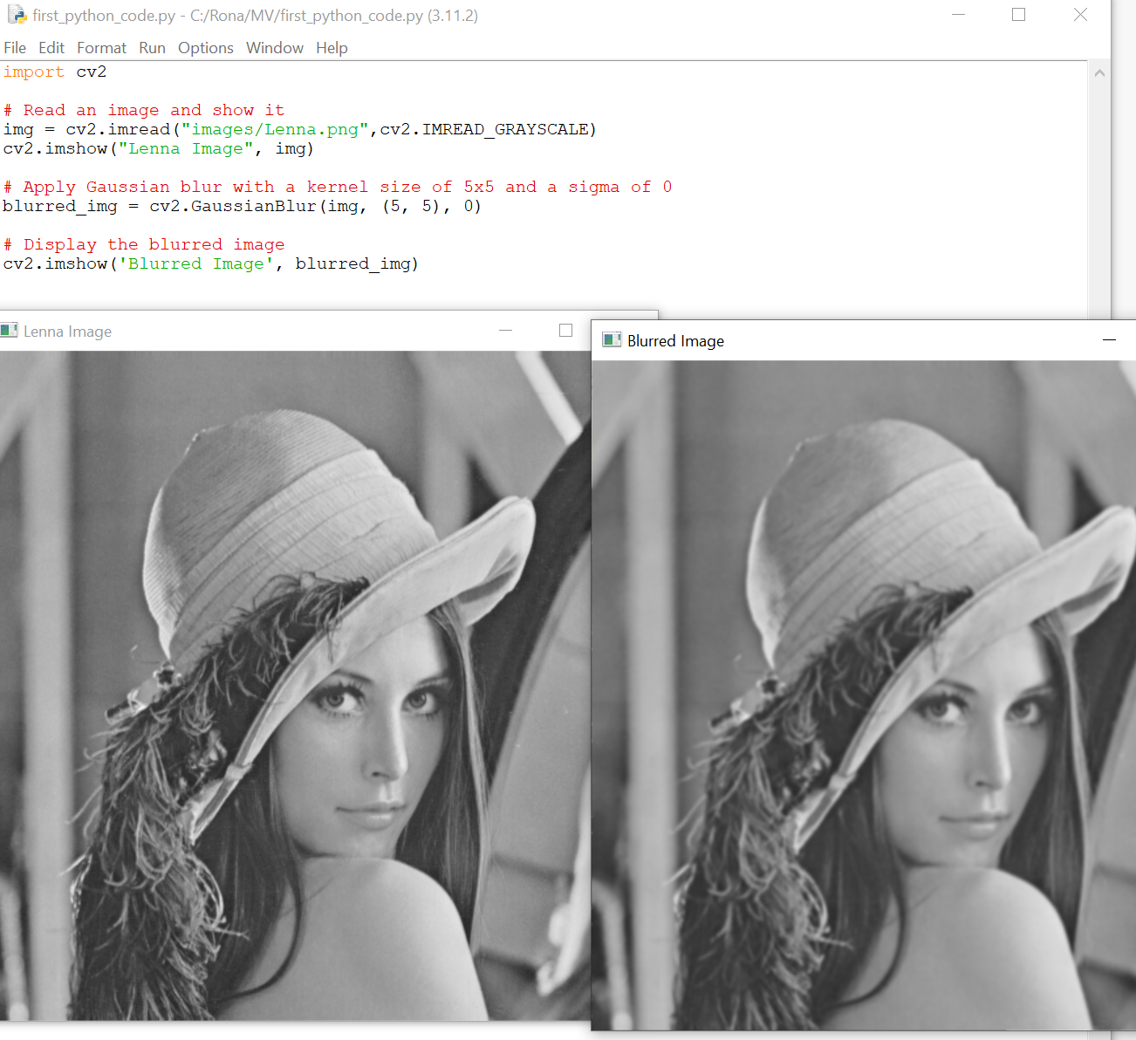
Image filtering
Blurring
Blurred images have less details
Blurred images look smoother
Blurring can be used for denoising

Slide 42
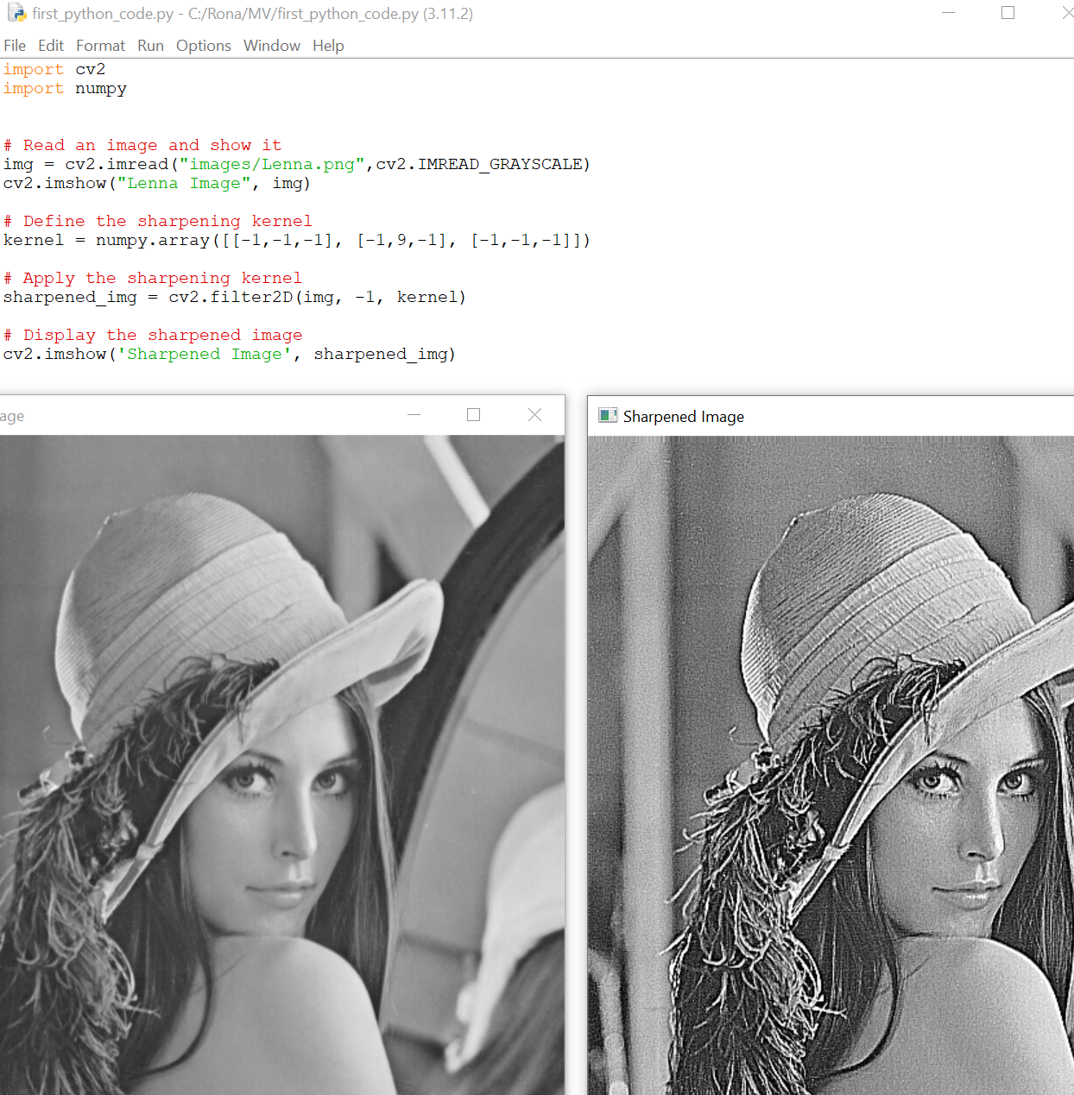
Image filtering
Sharpening

Slide 43
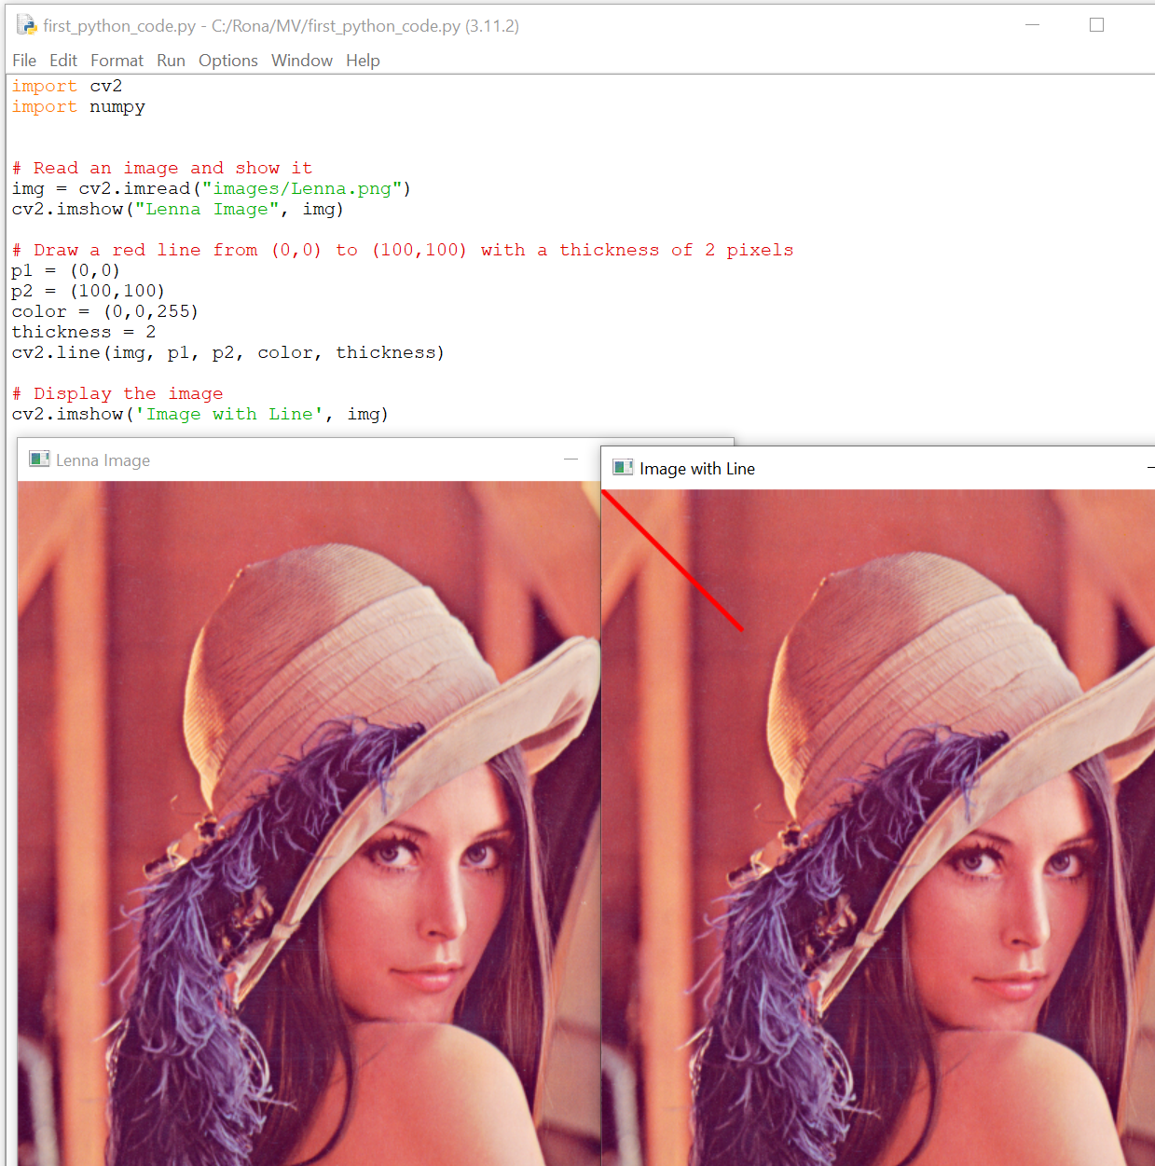
Drawing on images
Line

Slide 44
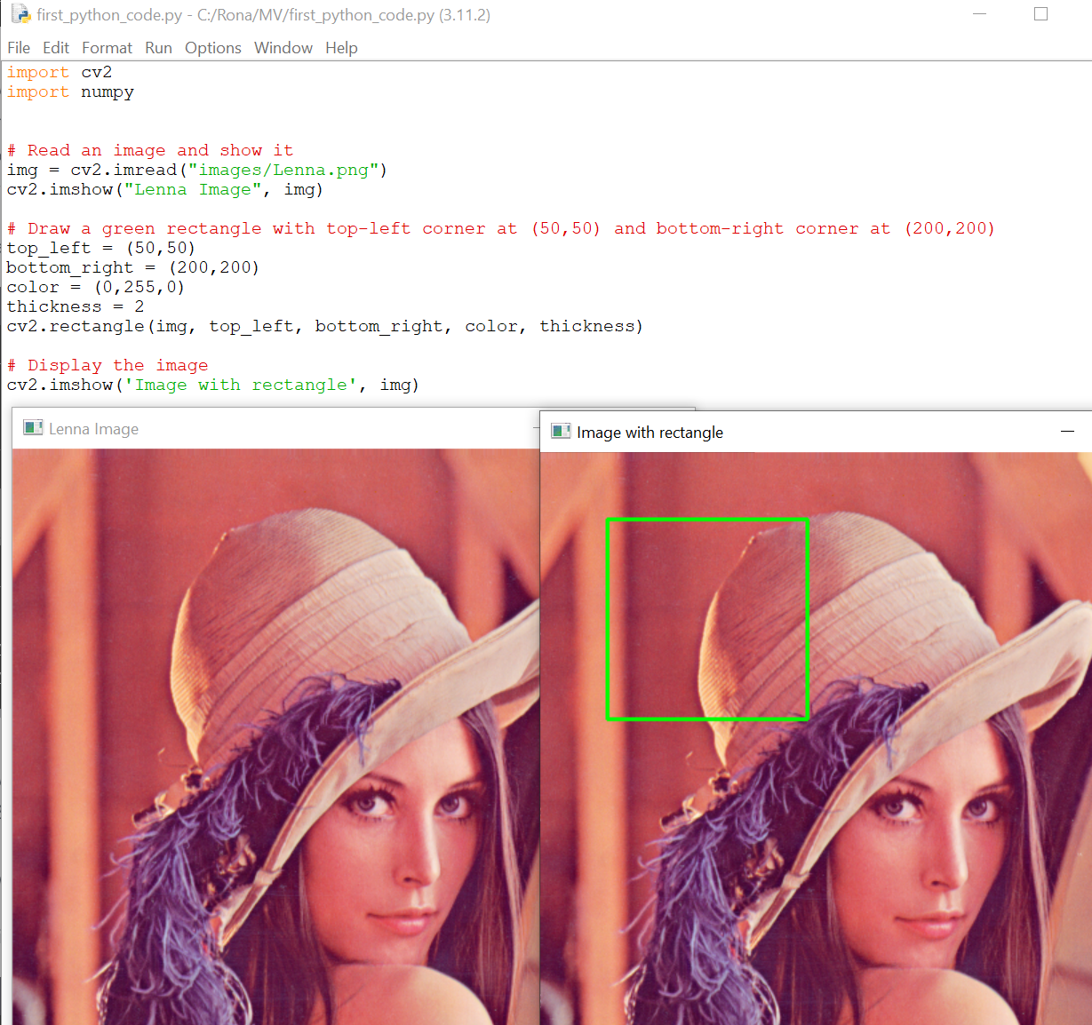
Drawing on images
Rectangle

Slide 45
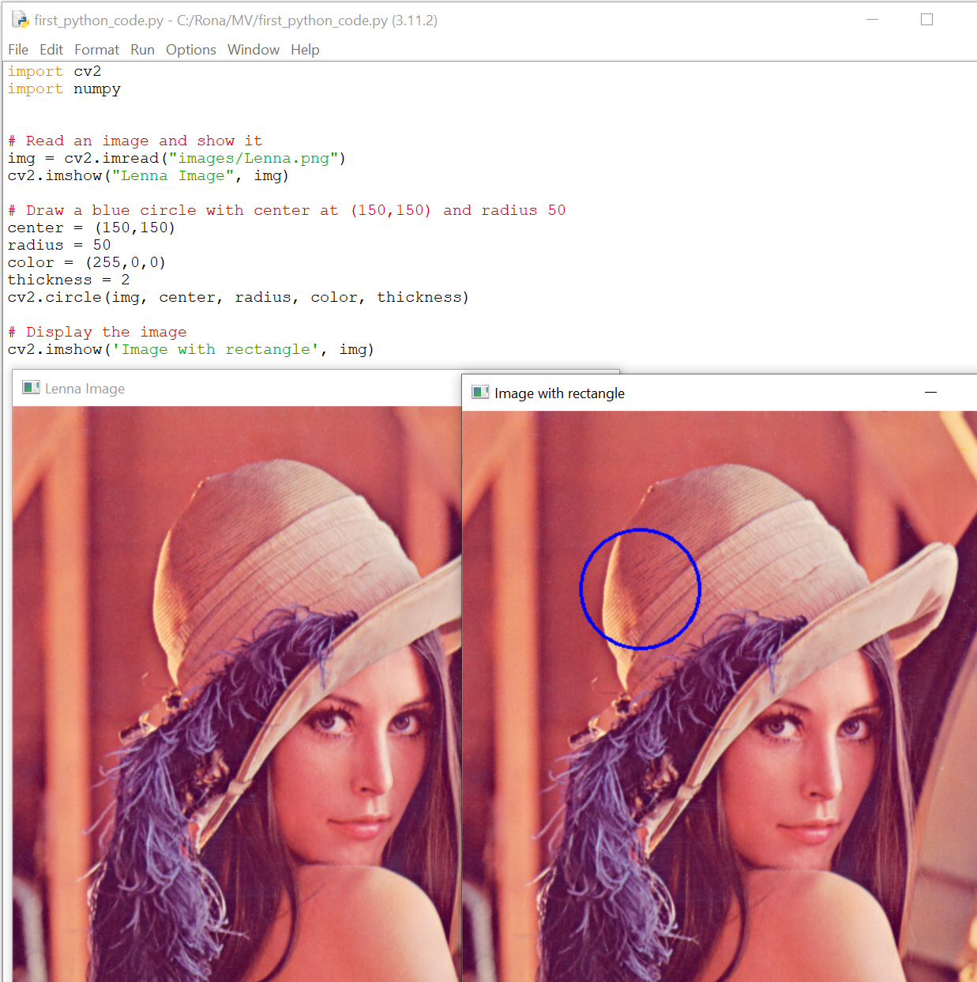
Drawing on images
Circle

Slide 46
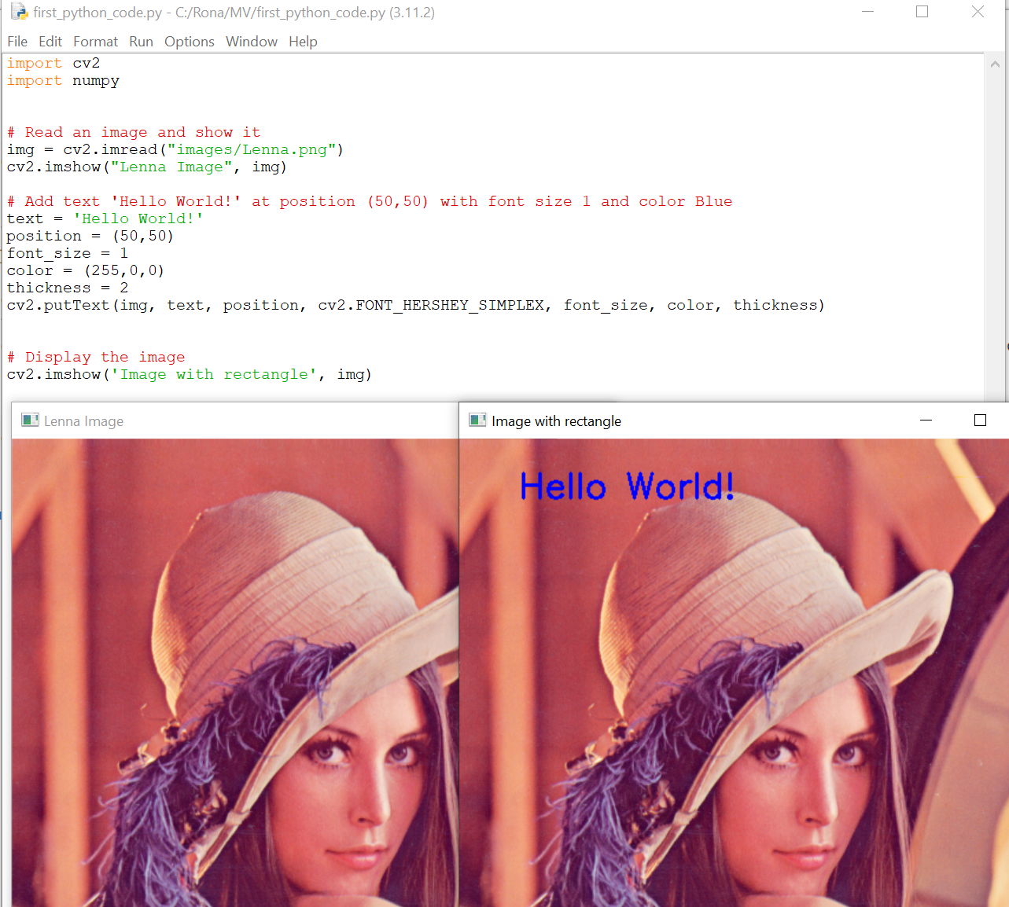
Drawing on images
Text

Slide 47
Object Detection

Slide 48
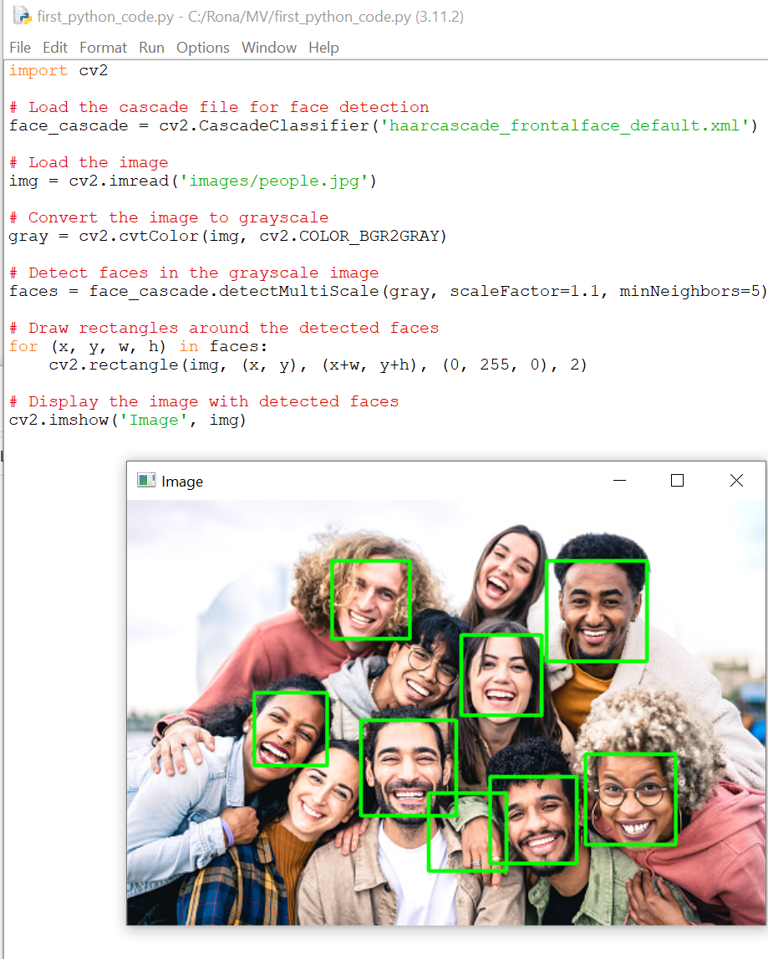
Object Detection
Face detection
The haarcascade_frontalface_default.xml file is a pre-trained
classifier provided by OpenCV for face detection.
https://github.com/opencv/opencv/tree/master/data/haarcascades
Haar classifier is a machine learning-based approach
for object detection in images and videos, and it is
implemented in the OpenCV library as a part of the cv2
Module.

Slide 49
More about Haar Classifier
The Haar classifier is based on the Haar wavelet transform, which can be used to extract features from an image. These features can then be used to train a classifier to detect objects in new images. The Haar classifier works by sliding a window over the input image and computing the Haar features for each window. The classifier then uses these features to classify each window as containing or not containing the object of interest.
Haar classifiers are commonly used for face detection and other object detection tasks. OpenCV provides pre-trained Haar classifiers for face, eye, and smile detection, among other things. These classifiers can be used directly or trained on new data to detect other objects.

Slide 50
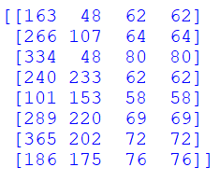
Detection results
print(type(faces))
Type: numpy array
print(faces.shape)
Shape: (8, 4) —> 8 people detected and for each one we have 4 values
print(faces)
Each detected face: [x1,y1, width, height]

Slide 51
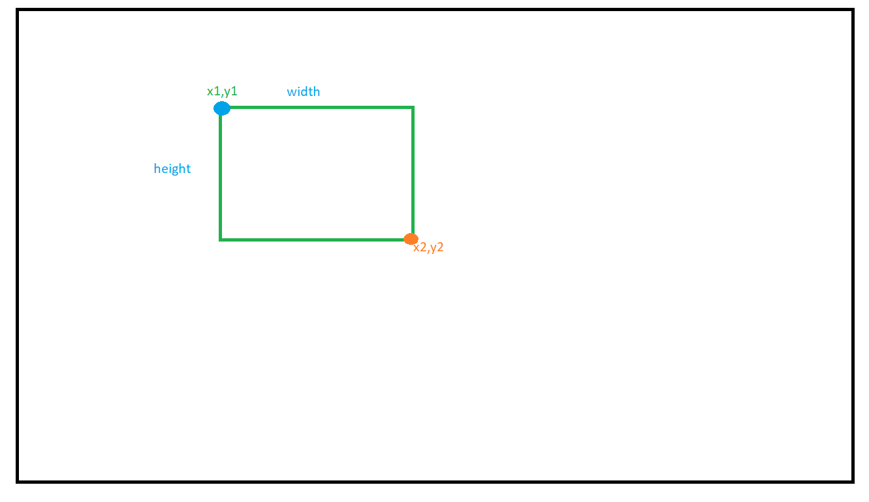
Finding the right values to draw rectangles

Slide 52
Finding the right values to draw rectangles
X1 = x
Y1 = y
X2 = x + width
Y2 = y + height

